Slide 1
Introduction to CSS

Slide 2
Objectives
What is CSS
Why to use CSS?
Embedded CSS to HTML Page
CSS Syntax and Selectors

Slide 3

What is CSS?
CSS stands for Cascading Style Sheets
CSS describes how HTML elements are to be displayed on screen, paper, or in other media
CSS saves a lot of work. It can control the layout of multiple
web pages all at once
External stylesheets are stored in CSS files

Slide 4
Why Use CSS?
CSS is used to define styles for your web pages, including the design, layout and variations in display for different devices and screen sizes.
CSS Saves a Lot of Work!
The style definitions are normally saved in external .css files.
With an external stylesheet file, you can change the look of an entire website by changing just one file!

Slide 5
CSS Solved a Big Problem
HTML was NEVER intended to contain tags for formatting a web page!
HTML was created to describe the content of a web page, like:
<h1>This is a heading</h1>
<p>This is a paragraph.</p>
When tags like <font>, and color attributes were added to the HTML 3.2 specification, it started a nightmare for web developers. Development of large websites, where fonts and color information were added to every single page, became a long and expensive process.
To solve this problem, the World Wide Web Consortium (W3C) created CSS.
CSS removed the style formatting from the HTML page!

Slide 6
1.5 Embedded CSS to HTML Page
When a browser reads a style sheet, it will format the HTML document according to the information in the style sheet.
There are three ways of inserting a style sheet:
External style sheet
Internal style sheet
Inline style

Slide 7
External Style Sheet
With an external style sheet, you can change the look of an entire website by changing just one file!
Each page must include a reference to the external style sheet file inside the <link> element. The <link> element goes inside the
<head> section:
Example
<head>
<link rel="stylesheet" type="text/css" href="mystyle.css">
</head>

Slide 8
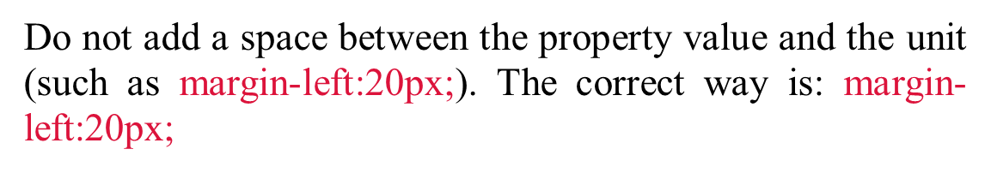

An external style sheet can be written in any text editor. The file should not contain any html tags. The style sheet file must be saved with a .css extension.
External Style Sheet
Here is how the "myStyle.css" looks:
body {
background-color: lightblue;
}
h1 {
color: navy; margin-left: 20px;
}

Slide 9
Internal Style Sheet
An internal style sheet may be used if one single page has a unique style.
Internal styles are defined within the <style> element, inside the
<head> section of an HTML page:

Slide 10
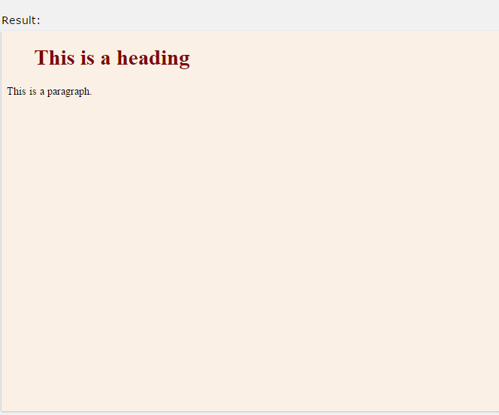
Internal Style Sheet
Example
<head>
<style> body {
background-color: linen;
}
h1 {
color: maroon; margin-left: 40px;
}
</style>
</head>

Slide 11
Inline Styles
An inline style may be used to apply a unique style for a single element.
To use inline styles, add the style attribute to the relevant element. The style attribute can contain any CSS property.
The example below shows how to change the color and the left margin of a <h1> element:
Example
<h1 style="color:blue;margin-left:30px;">This is a heading.</h1>

Slide 12
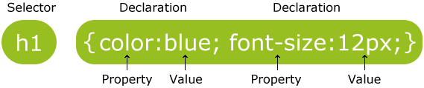
CSS Syntax and Selectors
CSS Syntax
A CSS rule-set consists of a selector and a declaration block:
The selector points to the HTML element you want to style.
The declaration block contains one or more declarations separated by semicolons.
Each declaration includes a CSS property name and a value, separated by a colon.

Slide 13
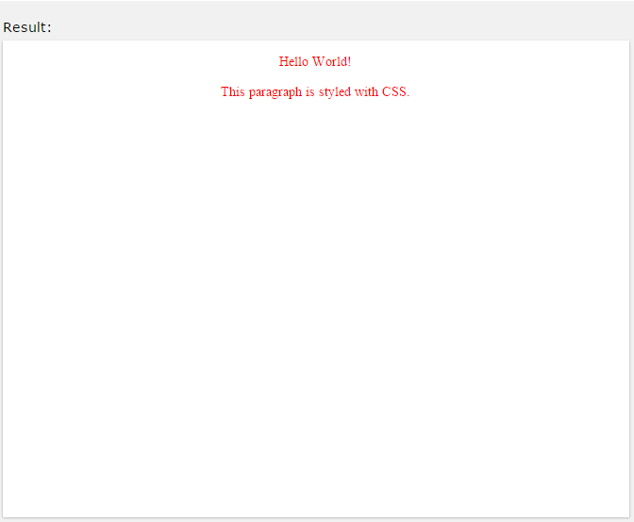
CSS Syntax
A CSS declaration always ends with a semicolon, and declaration blocks are surrounded by curly braces.
In the following example all <p> elements will be center-aligned, with a red text color:
Example
p {
color: red;
text-align: center;
}

Slide 14
CSS Selectors
CSS selectors are used to "find" (or select) HTML elements based on their element name, id, class, attribute, and more.
The element Selector
The element selector selects elements based on the element name. You can select all <p> elements on a page like this (in this case, all
<p> elements will be center-aligned, with a red text color):

Slide 15
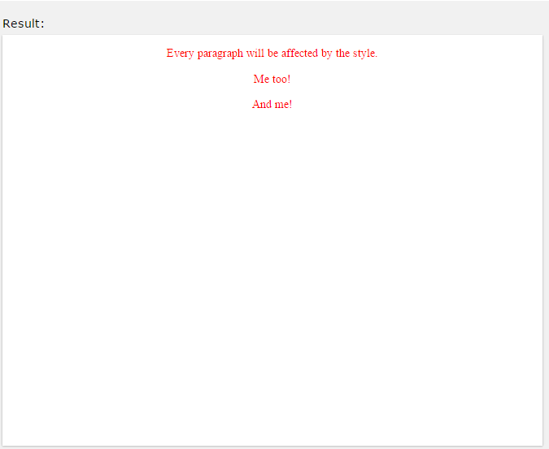
The element Selector
Example
p {
text-align: center; color: red;
}

Slide 16

The id Selector
The id selector uses the id attribute of an HTML element to select a specific element.
The id of an element should be unique within a page, so the id selector is used to select one unique element!
To select an element with a specific id, write a hash (#) character, followed by the id of the element.
The style rule below will be applied to the HTML element with id="para1":
#para1 {
text-align: center; color: red;
}

Slide 17
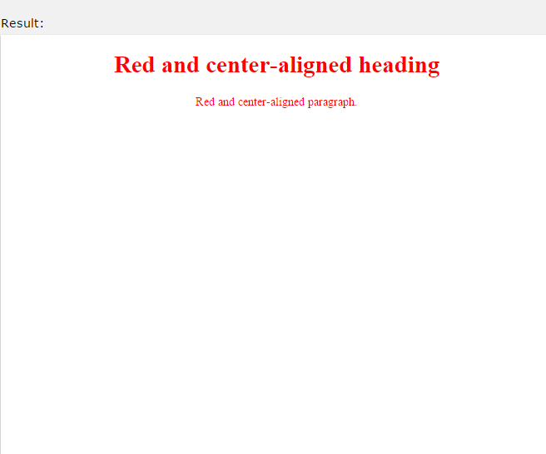
The class Selector
The class selector selects elements with a specific class attribute.
To select elements with a specific class, write a period (.) character, followed by the name of the class.
In the example below, all HTML elements with class="center" will be red and center-aligned:
Example
.center {
text-align: center; color: red;
}

Slide 18
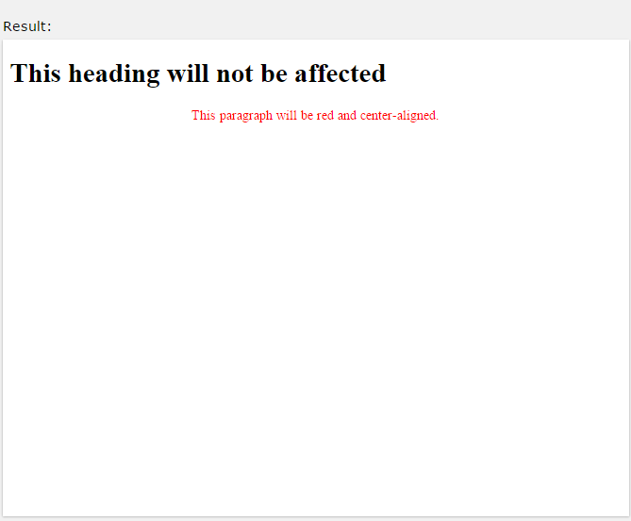
The class Selector
In the example below, only <p> elements with class="center" will be center-aligned:
Example
p.center {
text-align: center; color: red;
}

Slide 19
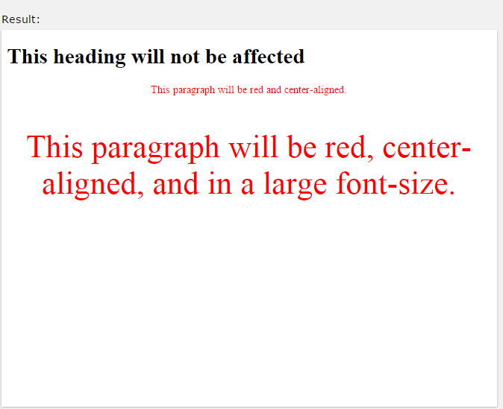
The class Selector
HTML elements can also refer to more than one class.
In the example below, the <p> element wil be styled according to class="center" and to class="large":
Example
<p class="center large">This paragraph refers to two classes.</p>

Slide 20
Grouping Selectors
If you have elements with the same style definitions, like this:
h1 {
text-align: center; color: red;
}
h2 {
text-align: center; color: red;
}
p {
text-align: center; color: red;
}

Slide 21
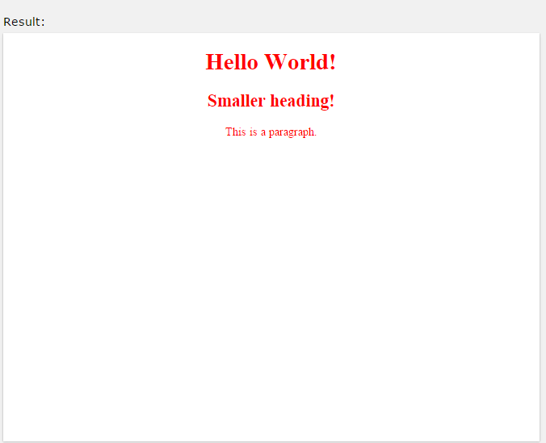
Grouping Selectors
It will be better to group the selectors, to minimize the code. To group selectors, separate each selector with a comma.
In the example below we have grouped the selectors from the code above:
Example
h1, h2, p {
text-align: center; color: red;
}

Slide 22
CSS Comments
Comments are used to explain the code, and may help when you edit the source code at a later date.
Comments are ignored by browsers.
A CSS comment starts with /* and ends with */. Comments can also span multiple lines:
p {
color: red;
/* This is a single-line comment */ text-align: center;
}
/* This is
a multi-line comment */

Slide 23
Cascading Order
What style will be used when there is more than one style specified for an HTML element?
Generally speaking we can say that all the styles will "cascade" into a new "virtual" style sheet by the following rules, where number one has the highest priority:
Inline style (inside an HTML element)
External and internal style sheets (in the head section) 3.Browser default
So, an inline style (inside a specific HTML element) has the highest priority, which means that it will override a style defined inside the <head> tag, or in an external style sheet, or a browser default value.

